Slide 1
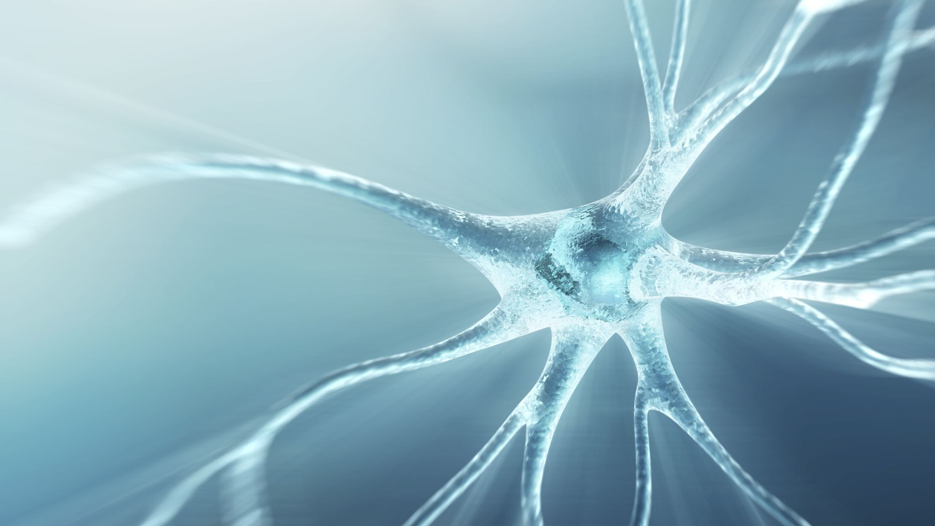
Intro to Deep learning

Slide 2
What is deep learning?

Slide 3
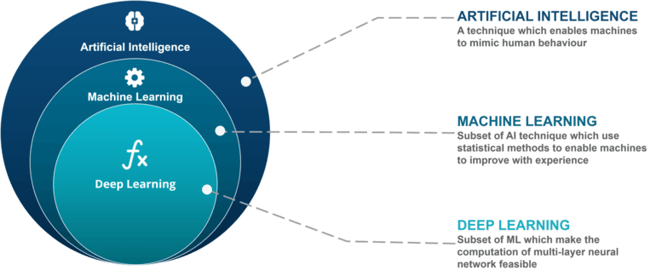
Machine Learning?
Deep learning is a subset of machine learning, which is a subset of A.I.
Machine learning uses algorithms to parse data, learn from that data, and make informed decisions based on what it has learned
Deep learning structures algorithms in layers to create an "artificial neural network” that can learn and make intelligent decisions on its own

Slide 4

Deep Learning
Deep learning isn’t new, but it has very gotten a lot of traction due to improvements in evaluating generic optimization problems.
Deep learning attempts to represent something with high-level features as a collection of lower-level features.
Deep learning resembles the neural connections that exist in the human brain.

Slide 5
Deep Learning
Deep learning is called as such because its algorithms are composed of several feature extracting transformations in series.
Examples:
Recommendation
Translation
Autonomous vehicles
Computer vision
Text generation
Style transfer
And so many more applications……

Slide 6
Basic concepts

Slide 7
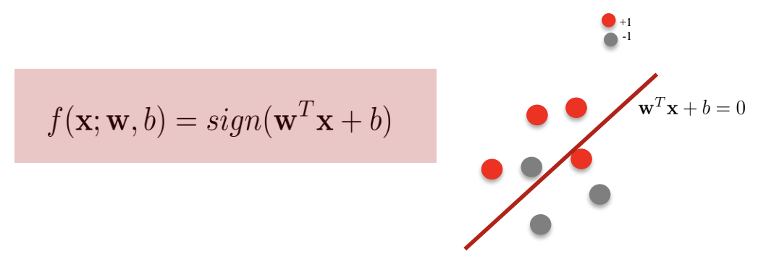
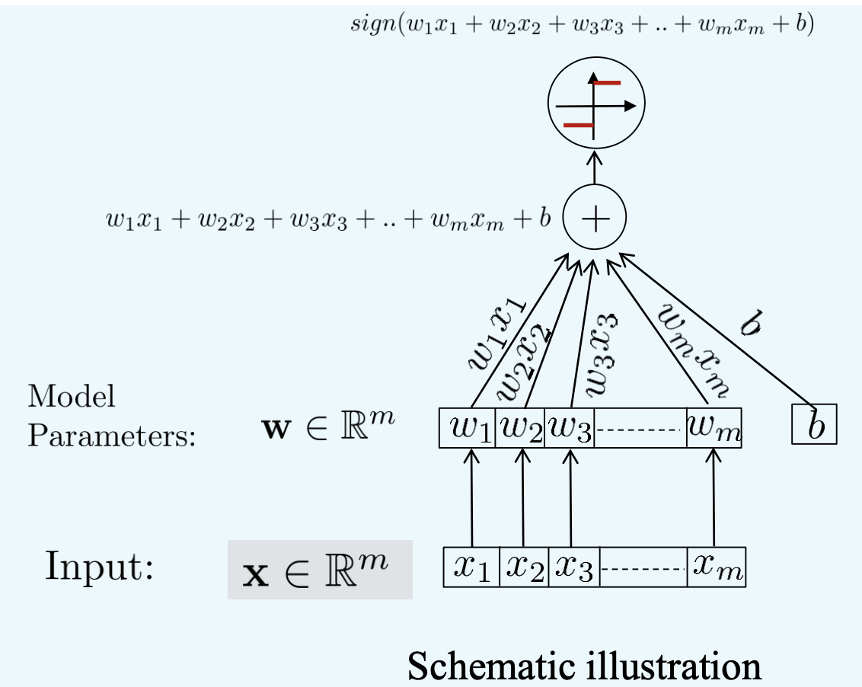
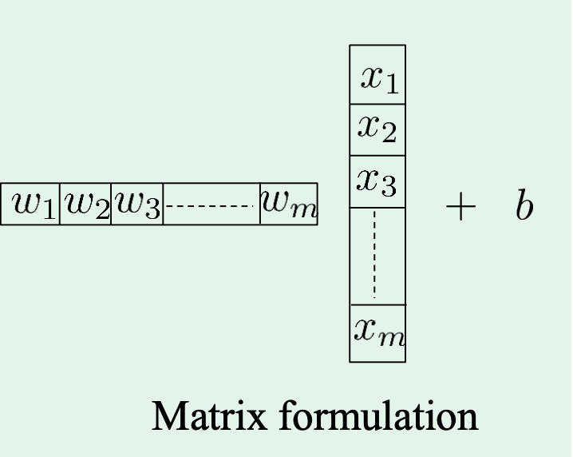
Perceptron
Perceptron is a linear classifier
Can be considered as a special “Neuron” with the sign function being the activation function of choice.
Note that the learning process is not strictly gradient descent but stochastic gradient descent.

Slide 8
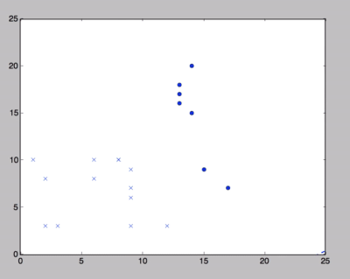
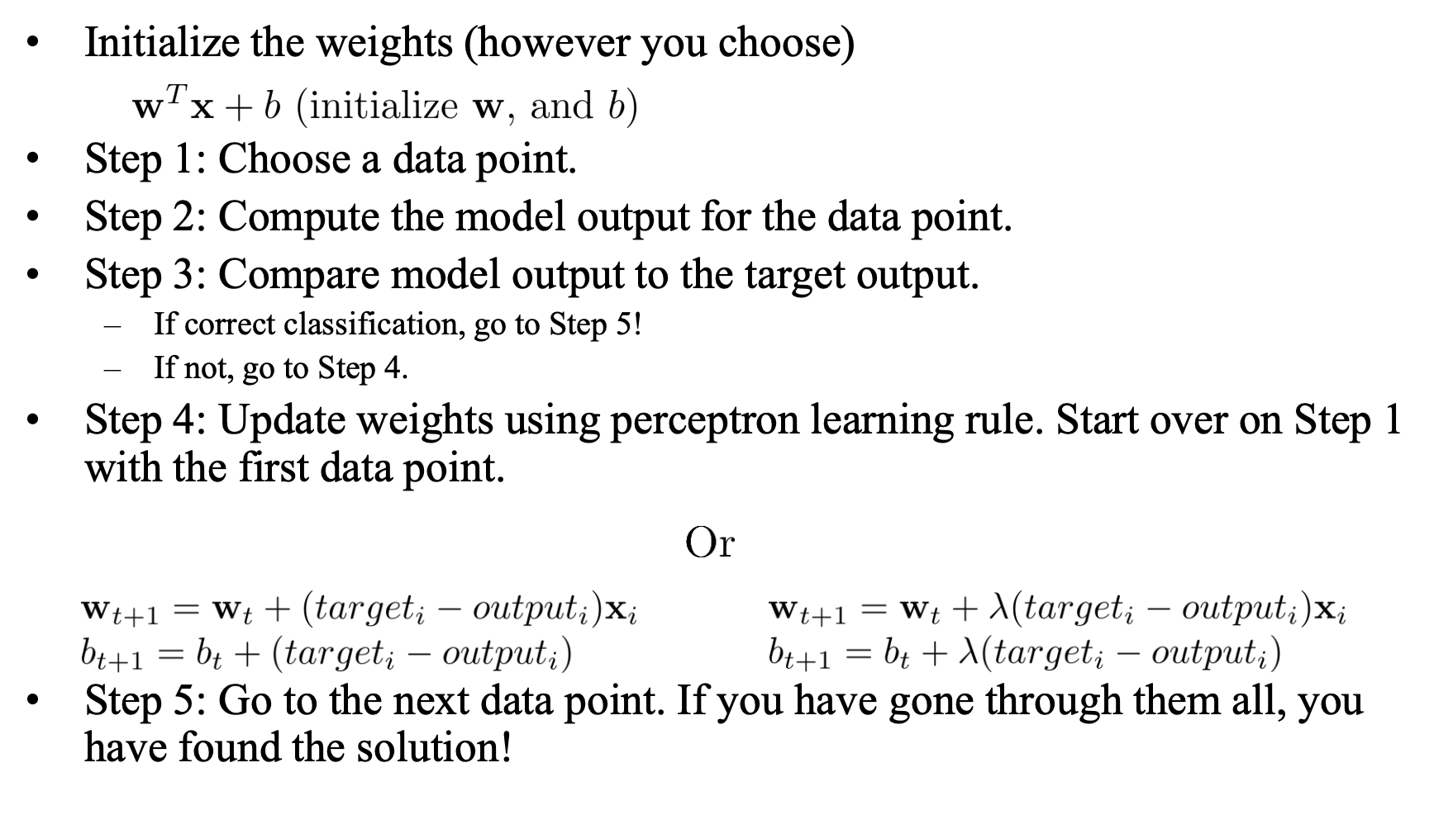
Perceptron

Slide 9

Gradient Descent
Gradient descent works for strictly convex functions, but neural networks are not strictly convex…
Stopping condition: gradient = 0
Where have we seen this to be the case?
Local Minima
Global Minima
Saddle Points
What should our goal be?

Slide 10
Gradient Descent
Minimize network losses using stochastic gradient descent (SGD). The generic implementation for a neural network is known as backpropagation.
[SGD] Randomly grab input, calculate the loss, and then backpropagate to update the model parameters.
Why do we choose SGD over GD?
A. It finds the global optimal solution.
B. It is computationally more efficient.
C. It is less memory demanding.
D. It avoids bad local optimal.
E. All of the above.

Slide 11
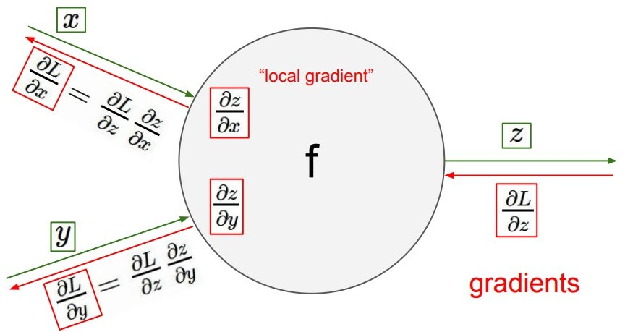
Back Propagation
Check out how backpropagation works more in depth with the CS231N material from Stanford!
Or take some courses offered here such as ECE 285, ECE 271B, CSE 190/253, COGS 181
Essentially finding the gradient using the chain rule and updating your equations.

Slide 12
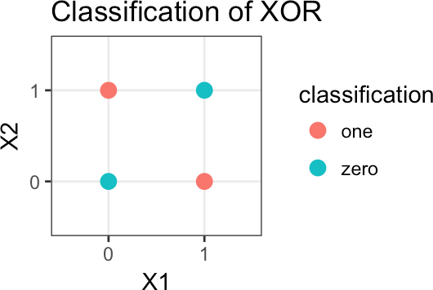
Why not perceptron?
Can you find a straight line that can be drawn across the graph that can divide the two classes on the right?
Obvious answer: No
So we have a reason to introduce non- linearities in the network. Without these non-linearities, it becomes impossible to model non-linear classification/regression problems such as the XOR classifier.

Slide 13
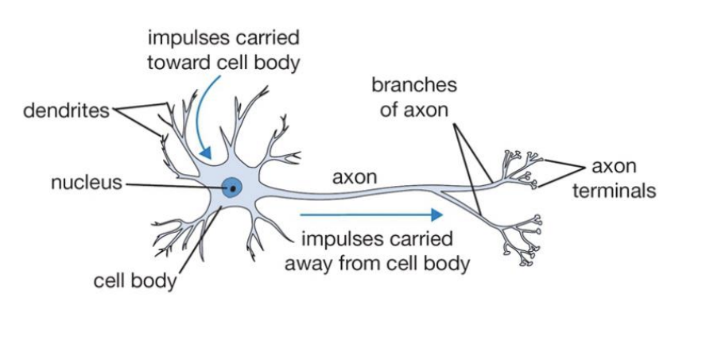
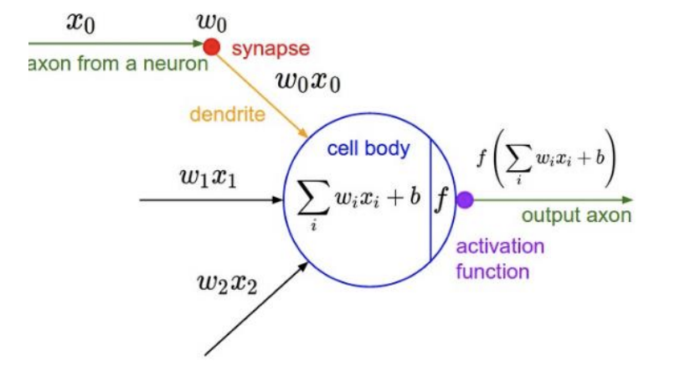
Neurons

Slide 14
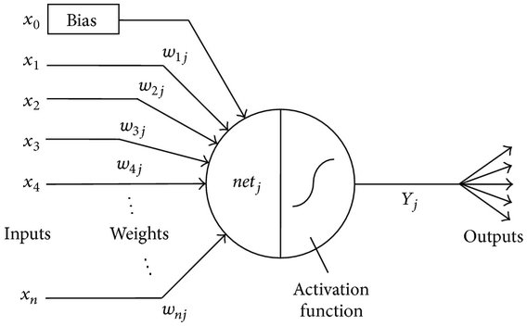
Neurons
The most fundamental network is comprised of “layers” of neurons.
These neurons are composed of:
Inputs, labeled [AKA features]
Weights associated with each input
An accumulation of the product of each input and weight
The activation function
The output or the input for the next neuron.
Note that the activation function determines whether the neuron is non-linear.

Slide 15
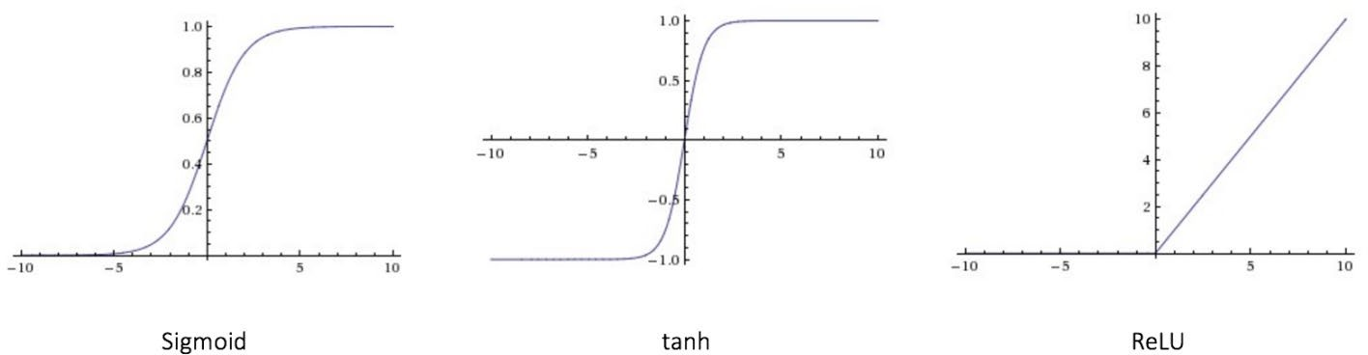
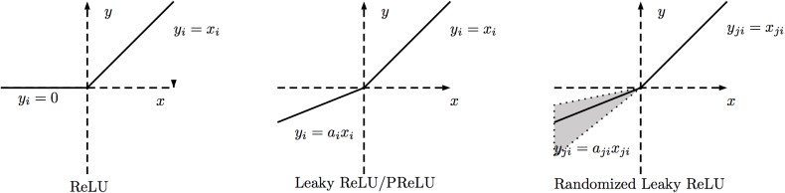
Activation Functions
The activation functions in the output layer determine non-linearity of the network. Typical examples:
Sigmoid, Tanh, ReLU, ReLU Alternatives
Softmax is generalization of sigmoid
In practice:
Use ReLU, careful with learning rate
Try out Leaky ReLU and other alternatives
Try out tanh but don’t expect much
Don’t use sigmoid

Slide 16
Loss Functions
Gives a measure of how “far away” the current predictions of the network are from the target for a specific task.
Be careful when choosing the loss function!
Example: Outliers with L1/L2 Loss. L2 overemphasizes outliers!
Many don’t even make sense in the context of certain problems!
Loss Functions
Cross-Entropy Loss [Binary Classification]
Multiclass Cross-Entropy [Multiclass Classification]
L1/L2 Loss [Usually Regression]
KL/etc. Divergences [Density Estimation]
And many others depending on application…
You will see that many usually create their own loss function as sums of these defined above!

Slide 17
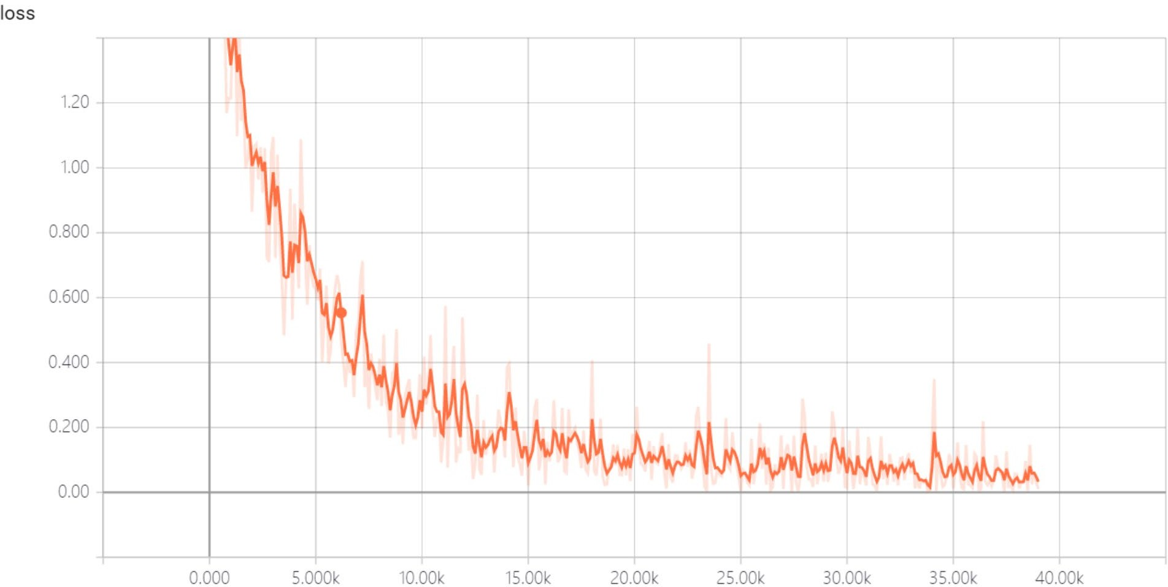
Loss Functions
So given a set of updated weights and our inputs, we can calculate our output by simply following the network through a forward propagation.
How can we measure how well our network is training?
Loss is what we minimize on, so clearly that should be all that we can look at, right?
No! Need to look at the results of our network on some data that it has not seen to make sure it is generalizing well!

Slide 18
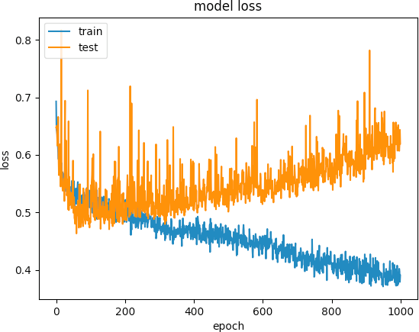
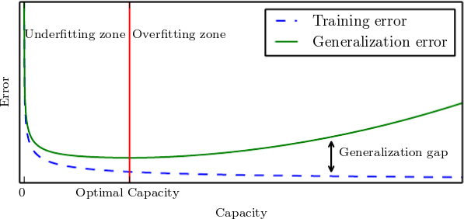
Loss Functions
Loss gives information as to whether the model currently training is “learning” anything. It does not mean that what is learned is representative of the dataset.
Always look at the training/validation error or accuracy as a metric of overfitting! Large separations indicate overfitting.
This means that we always have training/validation/testing split for our dataset.
With a small dataset, try data augmentation or a different training technique.

Slide 19
3Blue1Brown
It would be a feat to explain better than him so please check out his videos on deep learning if these concepts don’t really make sense yet.

Slide 20
Feed forward neural network

Slide 21
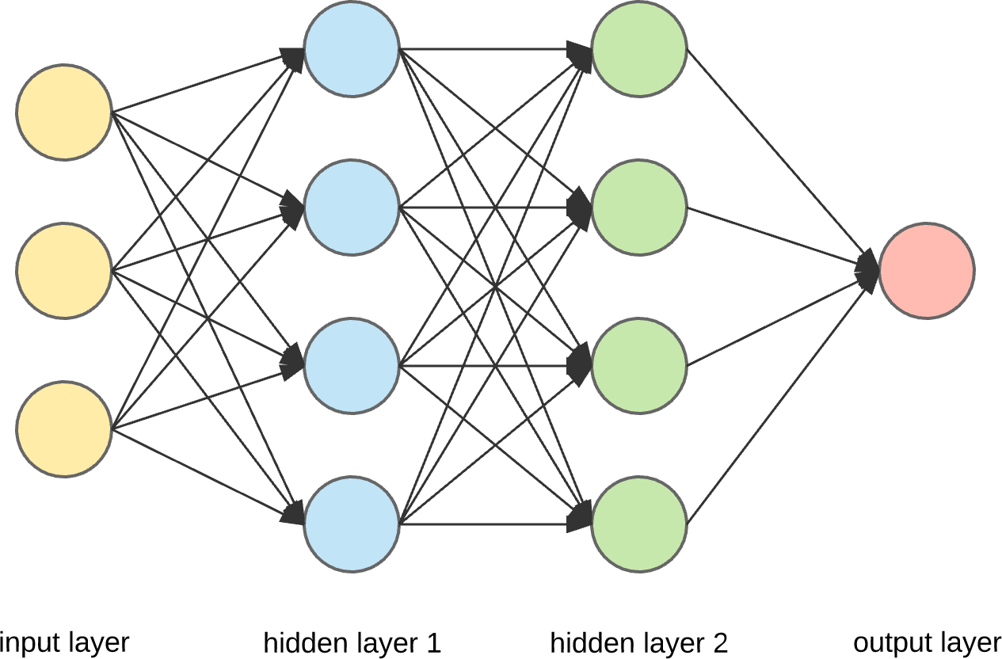
Multilayer Neurons
Sometimes Feed Forward Neural Network is loosely referred to Multilayer Perceptron (MLP)
Created by arranging neurons into layers and collecting signals from the neurons between the layers
This is the most basic form of a “deep” Artificial Neural Network

Slide 22
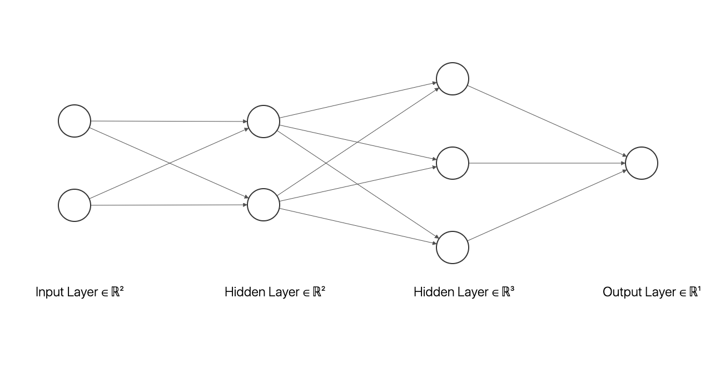
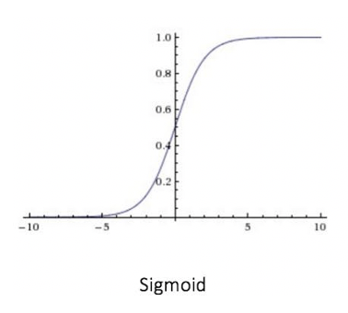
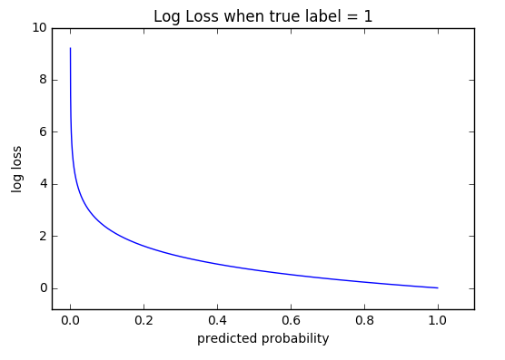
Algorithm
Determine your network structure, activation function, and loss function
Initialize the weights (however you choose but make sure the dimensions match up!)
For n number of iterations:
Step1: Get the loss of your neural network using the initialized weights and find the gradient
Step2: Update the weights using the gradient and learning rate
Step3: Rinse and repeat until last iteration

Slide 23
Convolutional neural network

Slide 24
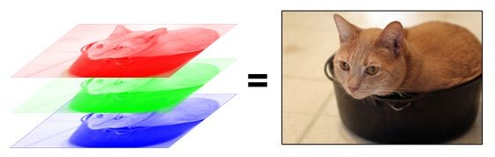
Images and Fully Connected Networks
FFNNs are great for applications where the number of features is somewhat small.
Consider the dimensionality of a 1080p image:
1920 x 1080 x 3 = 6220800 features
Larger the number of parameters to learn, the likelier it is for the model to overfit and the harder it is to learn!
Images change… Need a network that is stable against changes in the input image.
A cat can move, a camera’s quality can change, the environment never stays the same, etc…

Slide 25

Convolution and Kernels
A starting point for CNNs is to understand how convolution works within a convolutional layer. Each convolutional layer contains a learned filter or kernel (seen in yellow on the right).
A kernel can act as a detector for edges, curves, or more when it is slid and multiplied with image pixels.
By extracting desirable features from an image, dimensionality is reduced and a less sparse representation of the image is created.

Slide 26
Convolution and Kernels
Convolutions are essentially linear transformations with parameter sharing occurring in the transformation matrix (not proven here).
Pipeline for a convolutional neural network can be summarized as a dimensionality reduction with convolutional layers and then classification using fully connected layers!
Combine that with the shared kernel weights and you solve the two issues with using images as inputs!

Slide 27
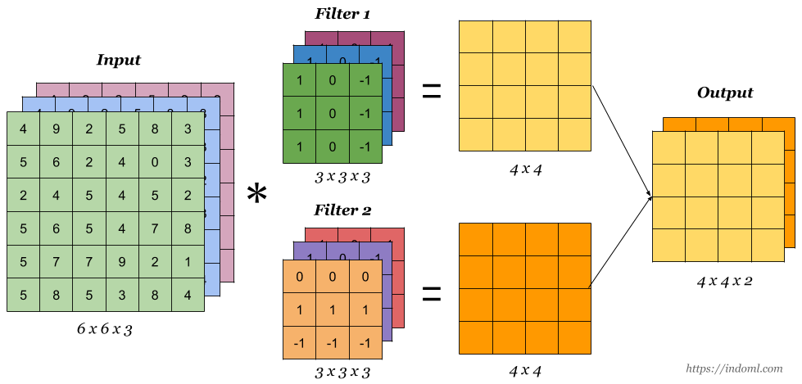
Convolutional Layers
While a single kernel might learn one particular attribute of an image, we generally want to learn several at a time to gain a better understanding of the image.
Convolutional layers consist of several kernels which are then convolved with the original image to generate the output channels.

Slide 28

Convolutional Layers (Attributes)
Stride
Amount by which window jumps as it passes through array.
Kernel Size
It is advised to not make them large as it has been shown that smaller kernels can still extract larger features as convolutional layers are applied in series.
Padding
Provides padding to reproduce certain size at output.

Slide 29
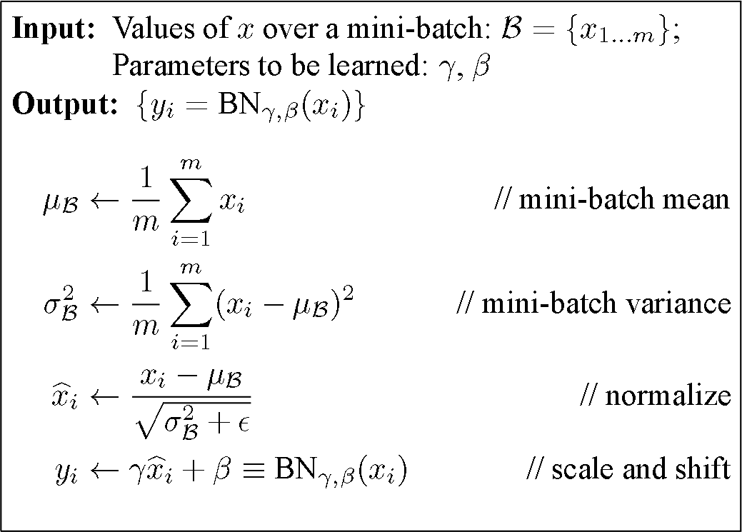
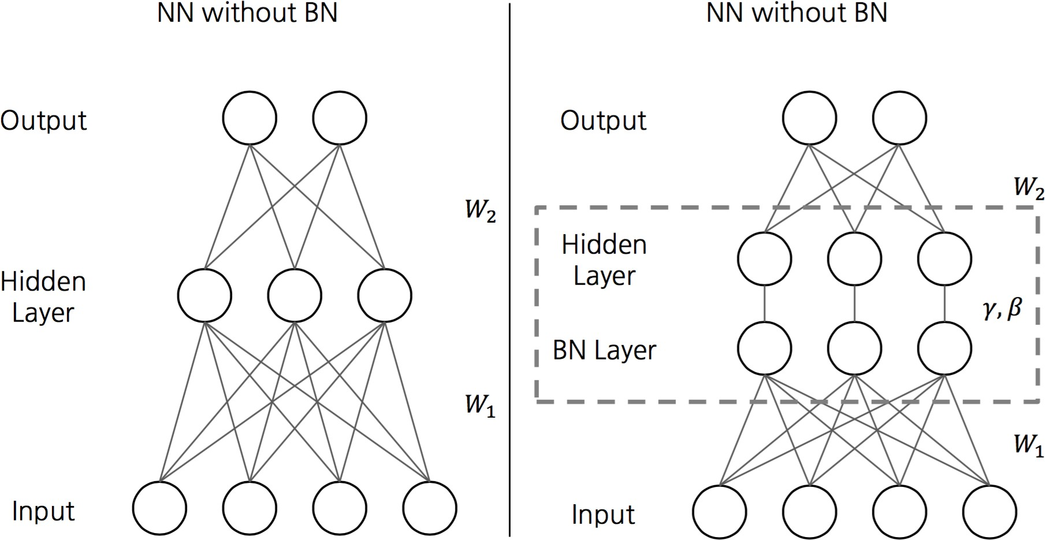
Batch Normalization (Layer)
Partially addresses the issue of (internal) covariate shift.
As the network is trained, the layers can each experience a type of “covariate shift”
Remember that normalization on the inputs allows for easier training of certain algorithms.
The same logic should apply for the activations in between layers! Remember that different batches generate different layer output distributions.
Can act as regularization due to noisy batch mean/variances

Slide 30

Pooling Layers
Pool the values in every 𝑁𝑁 × 𝑁𝑁 slice of the channels of the input and spit out either the average, maximum, or minimum of the slices with stride 𝑆𝑆.
Effectively a sliding window performing an avg/min/max operation over it’s area.
IE: The right represents two types of 2 × 2 pooling layer with a stride of 2.
But why?

Slide 31

Pooling Layers
Dimensionality Reduction
This is entirely in line with everything discussed for convolutional layers.
Positional / Rotational Invariance
If we suppose the activation maps for a given convolutional layer are affected by a change in the location of the subject in the input, then pooling these activations should lessen the impact of the change!
Do not make them too large or you lose too much information!

Slide 32
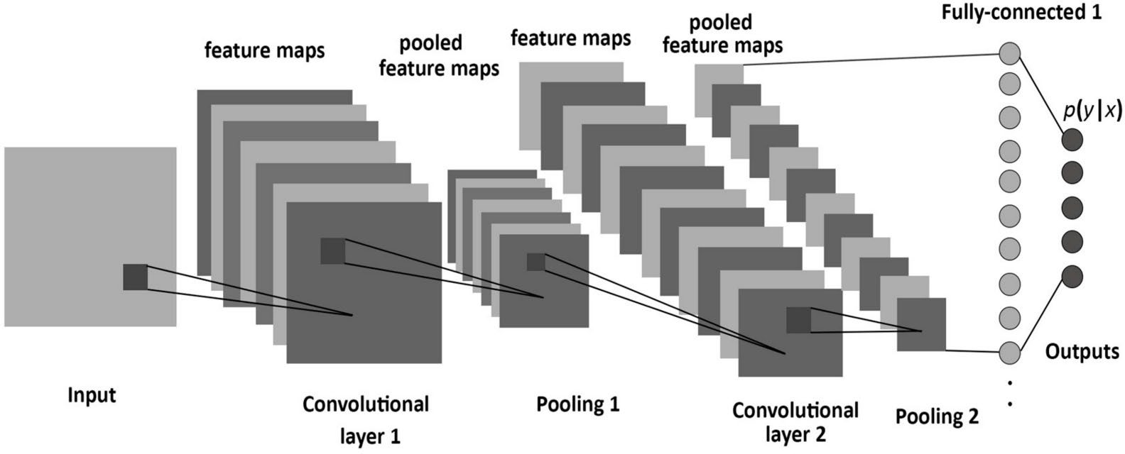
Fully Connected Layers
Luckily, convolutional and pooling layers make up most of what makes convolutional neural networks unique!
The fully-connected layer is simply neurons with flattened feature maps attained from the last convolution as the input.
Flattened, meaning, all values are concatenated into a long vector across rows and then channels.
No particular way of building CNNs exists either. Use experience to guide your model building…

Slide 33
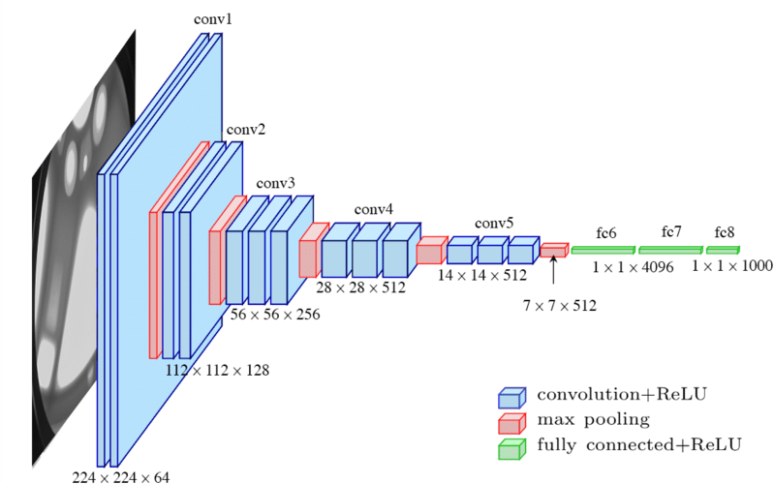
Convolutional Neural Networks
With all of these tools in hand, we are ready to discuss convolutional neural networks!
VGGNet is a CNN architecture with networks that consist of just convolutional layers and pooling layers
These make good study cases for people interested in convolutional neural networks. Since there is no complicated structure, it tends to be quite straightforward and used for quick training and inference!
Perfect example of how features become higher level as the inputs propagate through the network.

Slide 34
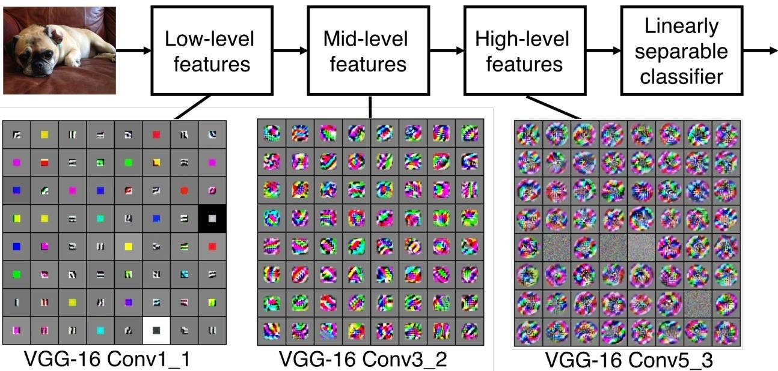
What Does A CNN Learn?

Slide 35
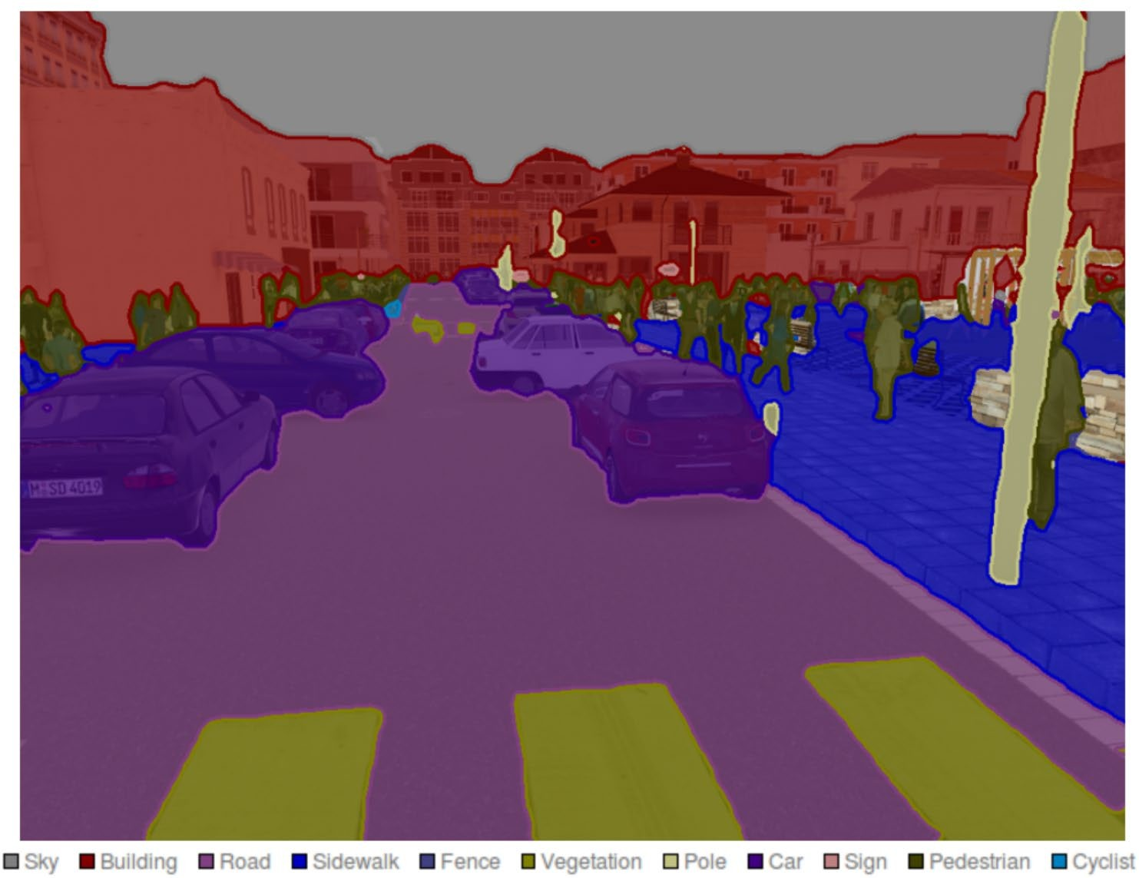
Common CNN Applications
Feature Extraction
Image Classification
Scene Labeling (Segmentation)
Image Generation
Image Analysis

Slide 36
More on CNN
Read more on CNN architectures (advanced):
LeNet
AlexNet
ZFNet
GoogLeNet
VGGNet

Slide 37

PyTorch
It’s a Python-based scientific computing package
A replacement for NumPy to use the power of GPUs
A deep learning research platform that provides maximum flexibility and speed

Slide 38
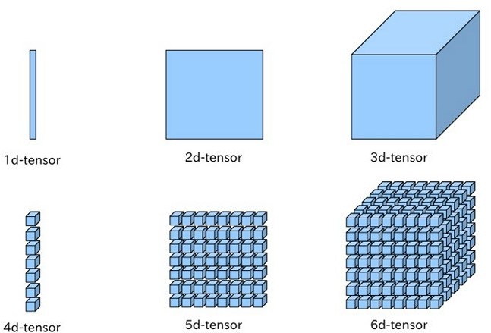
Tensors
Tensors are similar to NumPy’s ndarrays, with the addition being that Tensors can also be used on a GPU to accelerate computing
Essentially a representation of data AND linear transformations, both of which form the core of most learning algorithms.

Slide 39
Pipeline
PyTorch provides the elegantly designed modules and classes, including torch.nn, to help you create and train neural networks.
An nn.Module contains layers, and a method forward(input) that returns the output.
Follow this tutorial.

Slide 40
What else?

Slide 41
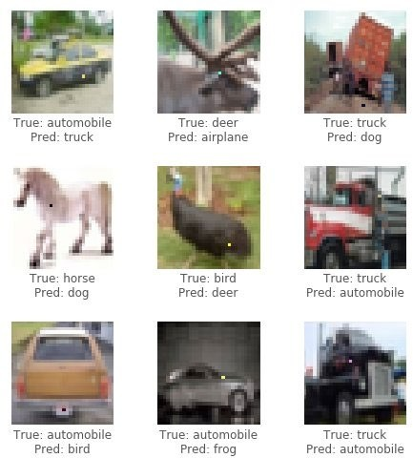
Dataset Considerations
Insufficient Intra/Inter – Class Variation
Symptoms:
Good Training and Testing Accuracy
Bad Generalization when Dataset Resampled
Remedies:
Re-sampling Data / Data Augmentation
Constraining Problem
Dataset Poisoning (Incorrect Distribution)
Symptoms:
Good Training / Bad Testing Accuracy
Remedies:
Inspecting & Removing Incorrectly Labeled Samples

Slide 42
Dataset Considerations
Class Imbalances
Symptoms:
Good Overall Accuracy / Terrible Class-wise Accuracy
Possible Remedies:
Weighed Loss Function
Data Augmentation
Distribution Estimation (Data Creation)

Slide 43
Types of NN and their applications
Check out this site if you’d like to implement deep learning for a problem but don’t know where to start.

Slide 44
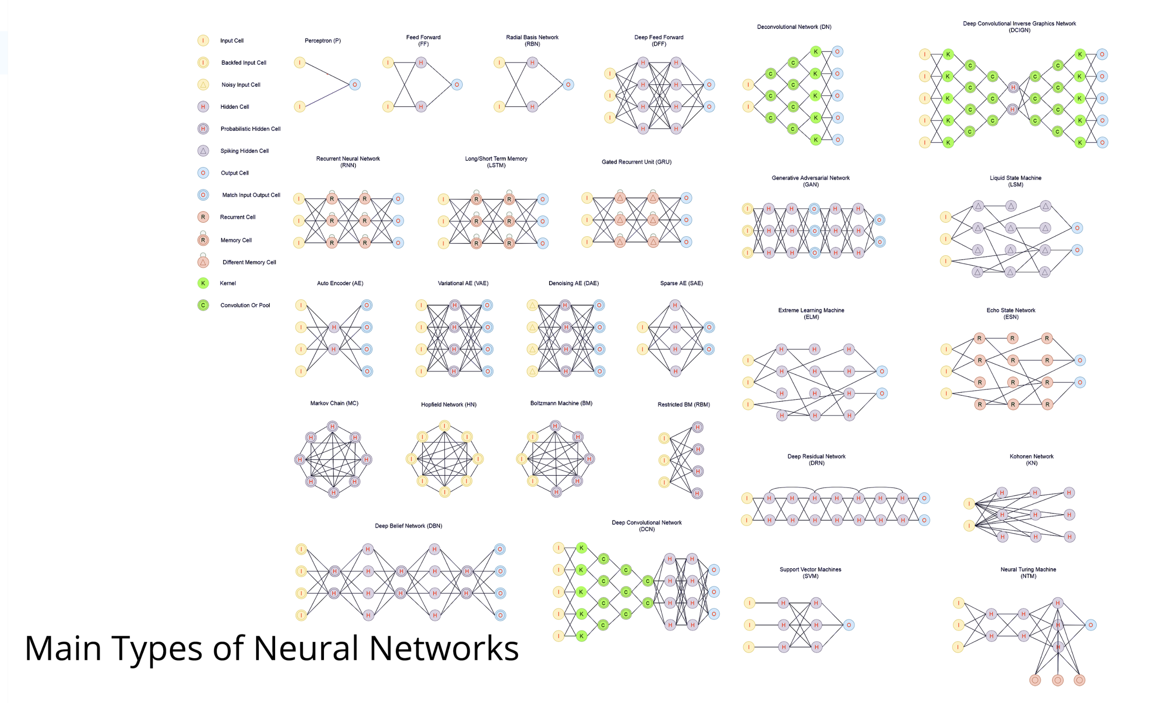

Slide 45

questions

